Slide 1

Major Project:
Seasonal Agriculture Performance Analysis
[Mohit Sigchi]
[Jalpaiguri Government Engineering College ]
AICTE STU ID : STU605da1eeefcd61616749038

Slide 2

PROBLEM STATEMENT
Agricultural activities are influenced by seasonal variations in environmental conditions, farming practices, resource availability and market conditions. As a result, agricultural performance may differ from one season to another.
However, raw agricultural data does not clearly explain how agricultural performance changes across seasons or what patterns can be observed in different seasonal conditions.
The problem is to analyze the given agricultural dataset and investigate seasonal differences in agricultural performance by identifying meaningful patterns, trends, relationships and variations within the available data.

Slide 3
Project Description
The dataset represents agricultural activities carried out across different seasons, geographical areas and farming conditions. It contains information related to farming practices, environmental conditions, crop production, resource usage and economic performance.
Seasonal variations can influence different aspects of agricultural activities and performance. Understanding seasonal patterns through data analytics can help stakeholders: • Understand variations in agricultural performance • Identify important seasonal trends • Compare performance across different periods • Understand changing environmental conditions • Examine differences in resource usage • Identify areas requiring further investigation • Support evidence-based agricultural planning
The primary objective of this project is to analyze agricultural data from different seasons and identify meaningful patterns, trends, relationships and differences in agricultural performance.
Expected Outcomes:
• Demonstrate an understanding of seasonal agricultural data.
• Perform appropriate data cleaning and preparation.
• Identify important seasonal patterns.
• Compare agricultural performance across seasons.
• Discover relationships and variations within the dataset.
• Select suitable analytical and visualization techniques independently.
• Interpret analytical findings correctly.
• Identify significant observations from the data.
• Develop evidence-based insights.
• Provide appropriate recommendations based on their findings.
• Document the complete analysis in a Jupyter Notebook.

Slide 4
Project Description
..continuation
Questions that needs to be answered:
Q1. How does agricultural performance vary across seasons?
Q2.What major seasonal patterns can be observed?
Q3.Which characteristics change between seasons?
Q4. What differences exist between agricultural activities in different seasons?
Q5.Are there noticeable variations in resource usage across seasons?
Q6. Are there relationships between seasonal environmental conditions and agricultural performance?
Q7. How do economic outcomes vary across seasons?
Q8. Are some seasonal patterns consistent across different regions or categories?
Q9. Are there unusual or unexpected seasonal patterns?
Q10. What insights can be derived from the observed seasonal differences?
Q11. What conclusions can reasonably be drawn from the available data?
Q12. How could the findings support better seasonal agricultural planning?

Slide 5

WHO ARE THE END USERS?
End Users of the Analysis
Farmers & Producer Organizations (FPOs): Guides crop selection per season (avoiding loss-making staples in Zaid without irrigation support) and transition from flood to drip irrigation.
Government Agricultural Departments & Policymakers: Directs seasonal Minimum Support Price (MSP) interventions, disaster/drought relief schemes for Zaid, and state-level subsidy allocations for micro-irrigation infrastructure.
Agricultural Extension Officers & Agronomists: Informs localized advisories on pest risk management (peaking in Kharif at 54.5%) and water-budgeting strategies.
Rural Credit Institutions & Crop Insurers: Provides empirical risk profiling for seasonal loan default and insurance underwriting (e.g., higher underwriting risk during Zaid where 64.5% of farms operate at a loss).
Agri-Input Suppliers & Supply Chain Managers: Guides inventory positioning for fertilizers, pesticides, and seeds aligned with seasonal demand peaks.

Slide 6

Technology Used
Technologies and Libraries Used
Programming Language: Python 3 (executed in Jupyter Notebook / Google Colab).
Pandas: Used for data ingestion (read_csv), structural audits (info, describe), median imputation, vector calculations (Profit_Margin_pct), multi-variable aggregations (groupby.agg), and pivot tables (pivot_table).
NumPy: Used for vectorized numerical operations, random number generation (np.random.default_rng), and constructing custom 5,000-iteration two-sided permutation hypothesis tests with Bonferroni correction.
Matplotlib (pyplot): Used for rendering multi-panel figures (subplots), bar charts, horizontal comparison plots, box-and-whisker distributions, and custom plot formatting.
Seaborn: Used for advanced multi-variable heatmaps (correlation matrix, state-by-season profit, and crop-by-season yield) and distribution boxplots.
Itertools (combinations): Standard library module utilized to generate pairwise seasonal combinations for permutation testing.

Slide 7
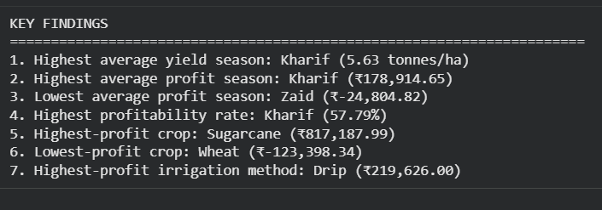
RESULTS

Slide 8
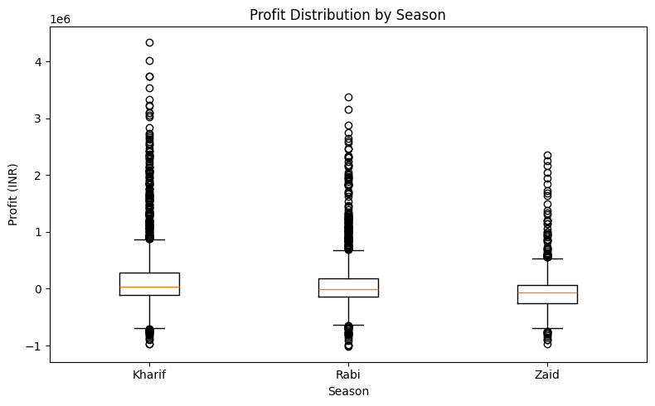
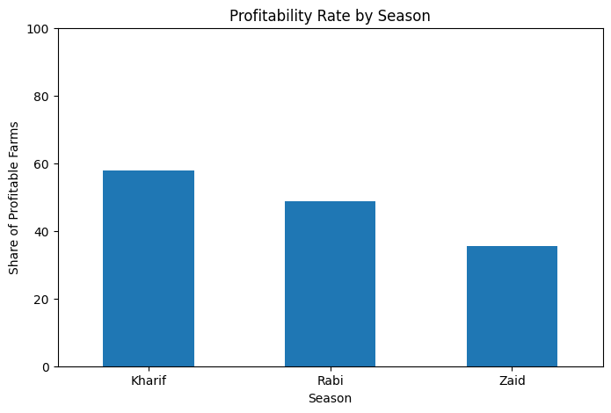
RESULTS

Slide 9
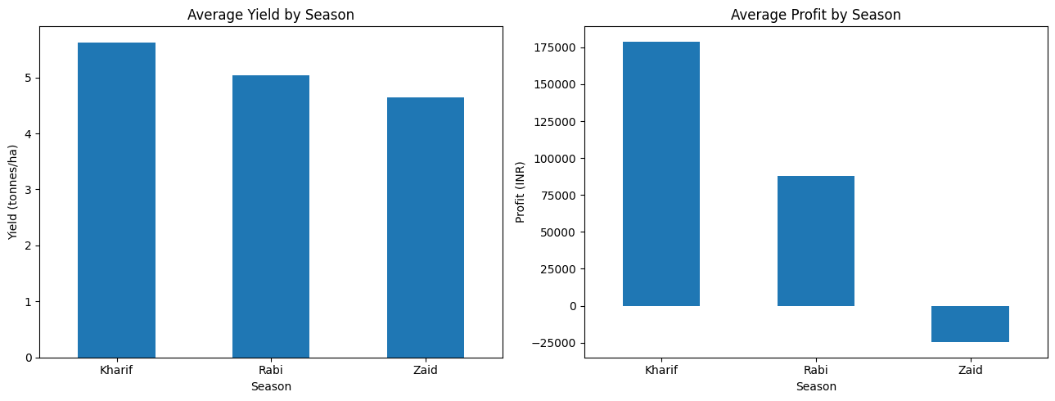
RESULTS

Slide 10
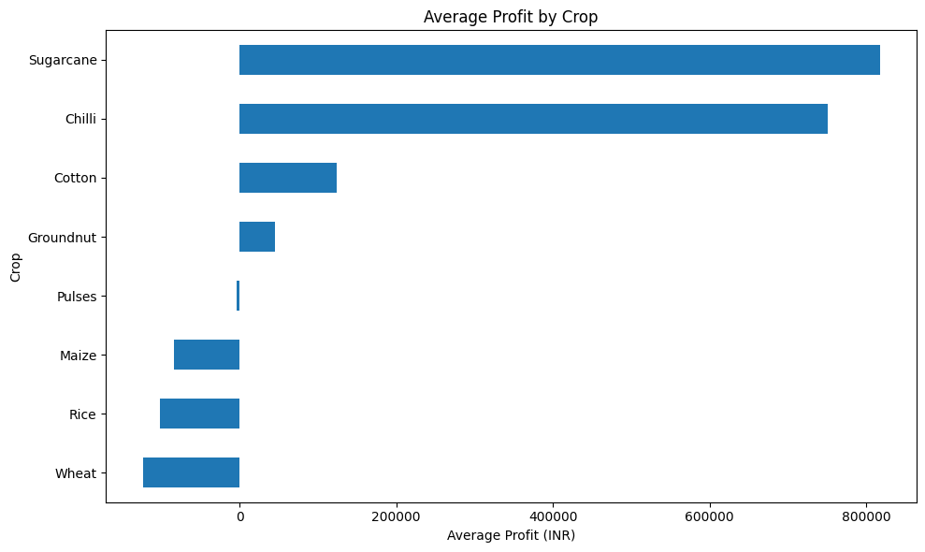
RESULTS

Slide 11
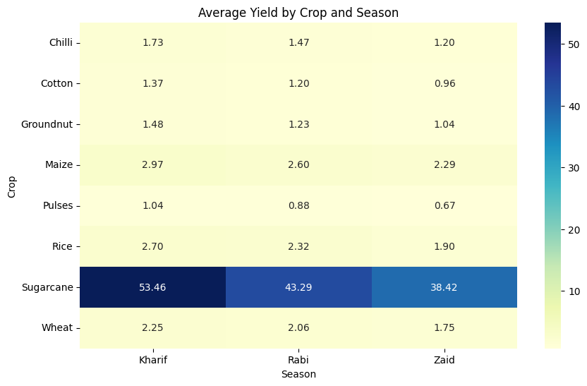
RESULTS

Slide 12
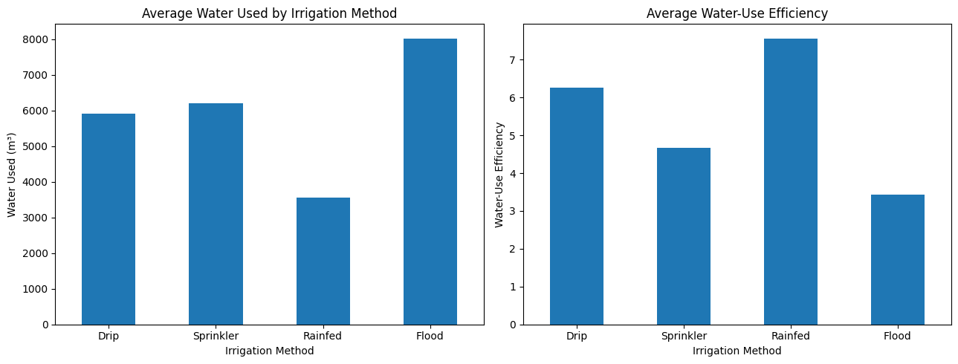
RESULTS

Slide 13
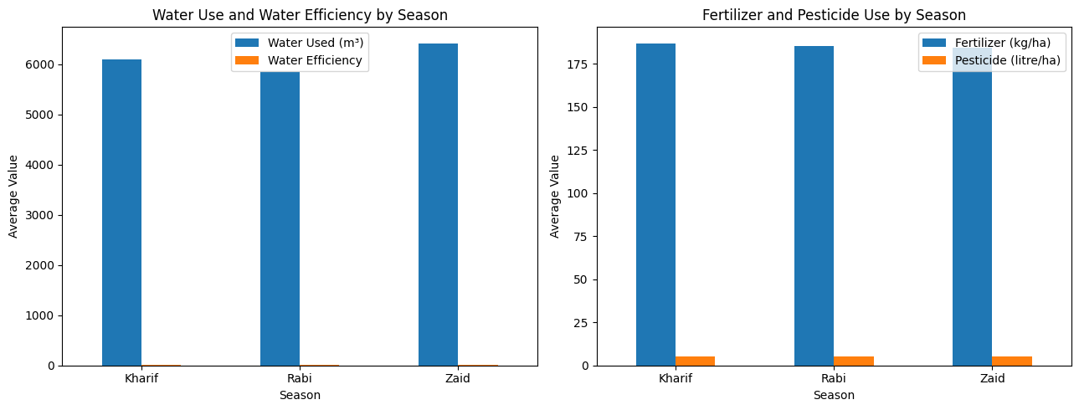
RESULTS

Slide 14
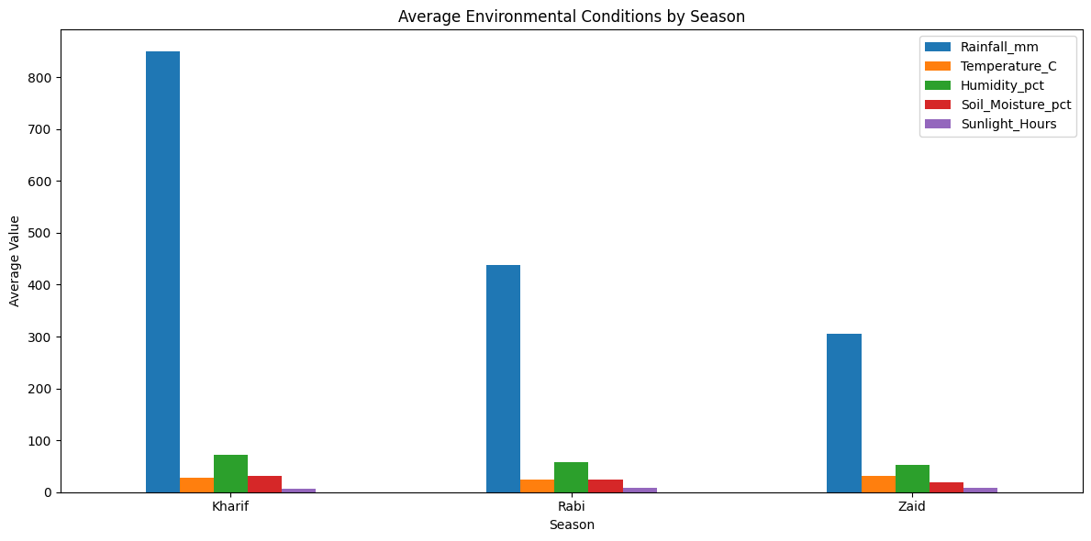
RESULTS

Slide 15
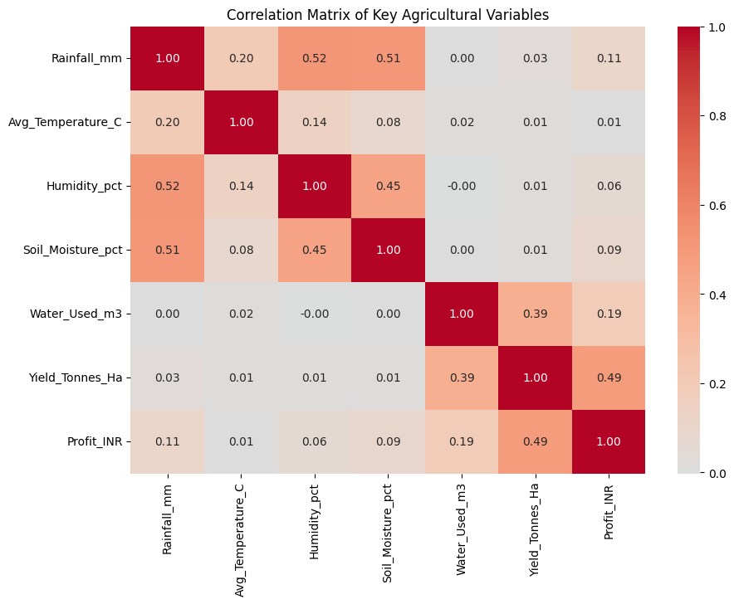
RESULTS

Slide 16
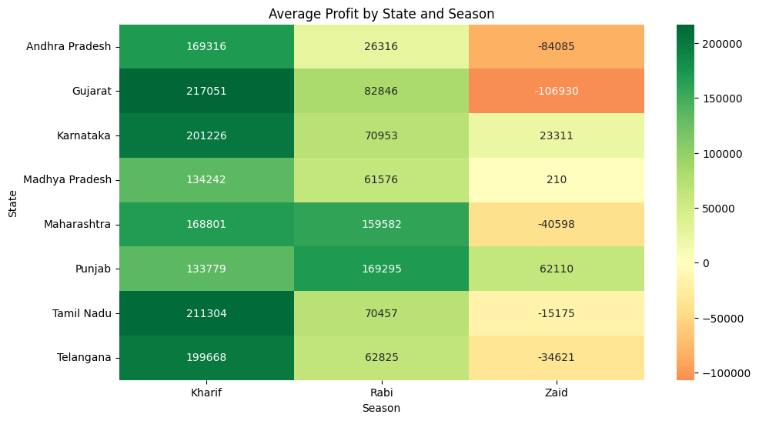
RESULTS

Slide 17
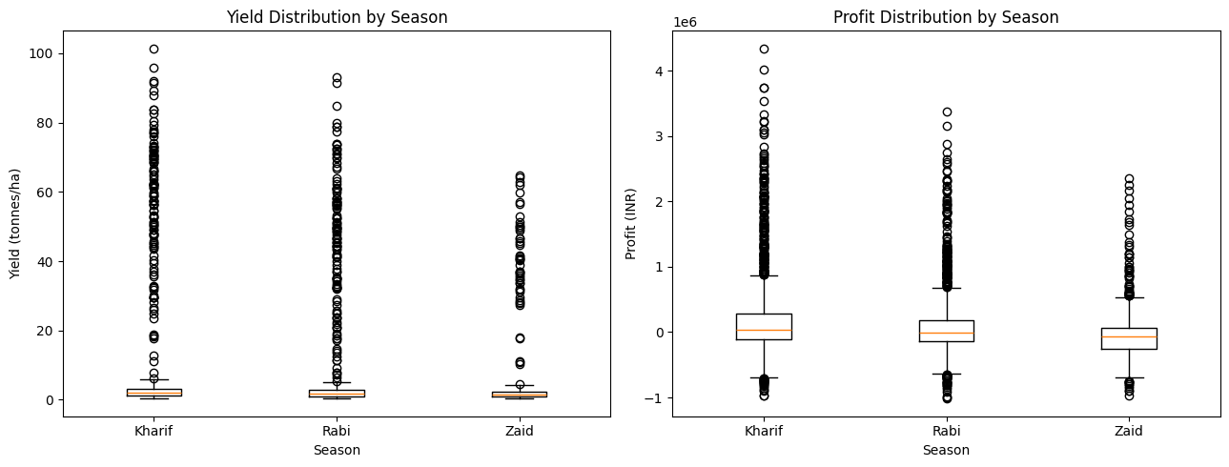
RESULTS

Slide 18
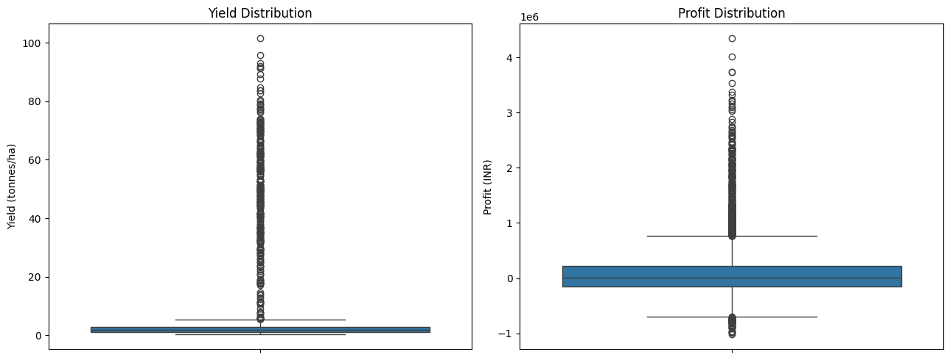
RESULTS

Slide 19

Future scope
1. Machine Learning & Predictive Modeling
Crop Recommendation: Build classification models (Random Forest, XGBoost) to suggest optimal crops based on soil nutrients ($\text{N, P, K, pH}$), farm size, and seasonal weather.
Yield & Profit Forecasting: Deploy regression pipelines to predict expected yield and net margins before sowing for proactive financial planning.
Pest & Disease Alerts: Train classifiers on humidity, rainfall, and temperature trends to flag outbreak risks weeks in advance.
2. Causal Inference & Economic Impact
Causal Impact Analysis: Apply causal frameworks (e.g., Propensity Score Matching) to isolate the true yield and profit benefits of drip versus flood irrigation.
Cost-Benefit Simulations: Model payback timelines and ROI for smallholders transitioning to micro-irrigation or hybrid seeds.
3. Data Expansion & Real-Time Ingestion
Satellite Remote Sensing: Integrate Sentinel-2 or Landsat imagery to monitor live crop health via vegetation indices (NDVI/EVI).
Live Market APIs: Connect to real-time mandi price feeds (e.g., Agmarknet) to provide dynamic harvesting and selling advisories.
IoT Sensor Telemetry: Ingest continuous ground-sensor data tracking soil moisture depletion and local microclimates.
4. Deployment & Decision Support
Interactive Dashboards: Develop web-based BI platforms (Streamlit, Power BI) for agricultural officers, insurers, and cooperatives.
Multilingual Mobile Advisories: Deliver localized recommendations on sowing windows, water rationing, and pest management via SMS, WhatsApp, or mobile apps.
5. Sustainability & Resource Optimization
Precision Input Scheduling: Use optimization algorithms to calculate minimum water and fertilizer application schedules that maximize yield.
Footprint Accounting: Measure greenhouse gas emissions and water depletion rates to support sustainable farming and ESG compliance.

Slide 20
GitHub Link
https://github.com/Sigchi98/Seasonal-Agriculture-Performance-Analysis.git

Slide 21
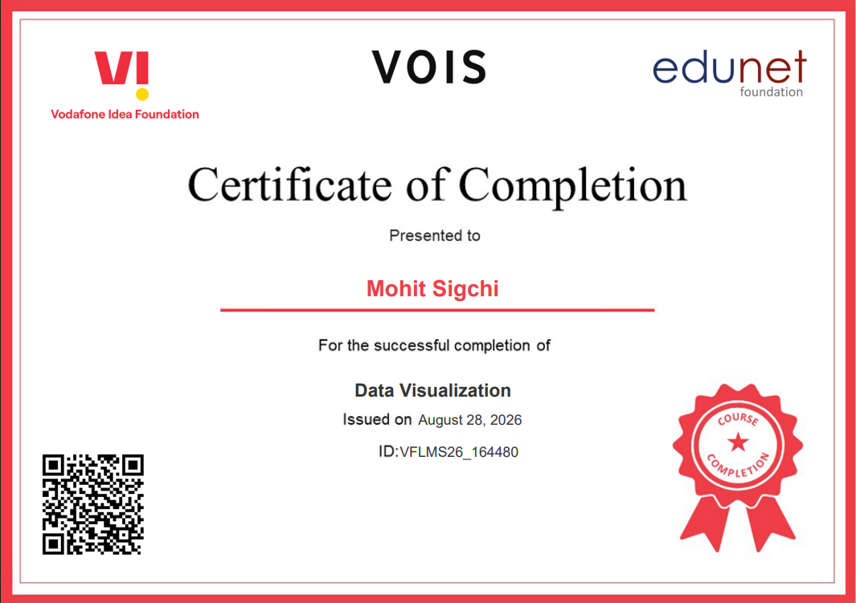
VOIS Course completion certificate -
Course name- Data Visualization

Slide 22
Thank you
Presenter: Mohit Sigchi
AICTE Student ID: STU605da1eeefcd61616749038
Program: VOIS AICTE Data Analytics Internship (10th Aug 2026 to 10th Sept 2026)
Project: Seasonal Agriculture Performance Analysis
Contact: AICTE EMAIL: ms2239@cse.jgec.ac.in |
VOIS LMS EMAIL: mohitsigchi@gmail.com |
Linkedin: linkedin.com/in/mohitsigchi|
Github Link: https://github.com/Sigchi98/Seasonal-Agriculture-Performance-Analysis.git |
Colab Link: https://colab.research.google.com/drive/1TdXwb-sWrLA9aCcV1VudkqmjcKOdPZzz?usp=sharing
.
.

